Slide 1
NON-PHOTOREALISTIC RENDERING TECHNIQUES
CS6610 FINAL PROJECT REPORT
Varsha Alangar

Slide 2
What is NPR
Non-Photorealistic Rendering (NPR) focuses on achieving non-realistic, artsy, cartoon like images.
TECHNIQUES:
Toon Shading
Gooch Shading
Hatching
Toon and Gooch shading techniques can be used in combination with Silhouette Detection and Contour Detection.

Slide 3
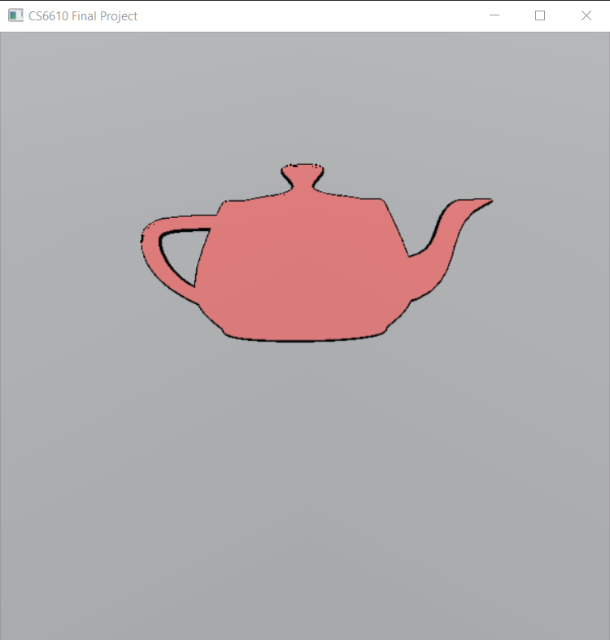
SILHOUETTE DETECTION
Determine the outline of an object.
Two passes:
Render an enlarged version of the object by shifting the vertices along its normal and applying a constant color (color of the outline)
Render the object like always over the enlarged image.
An offset is used to shift the vertices. Use very small offset value.

Slide 4
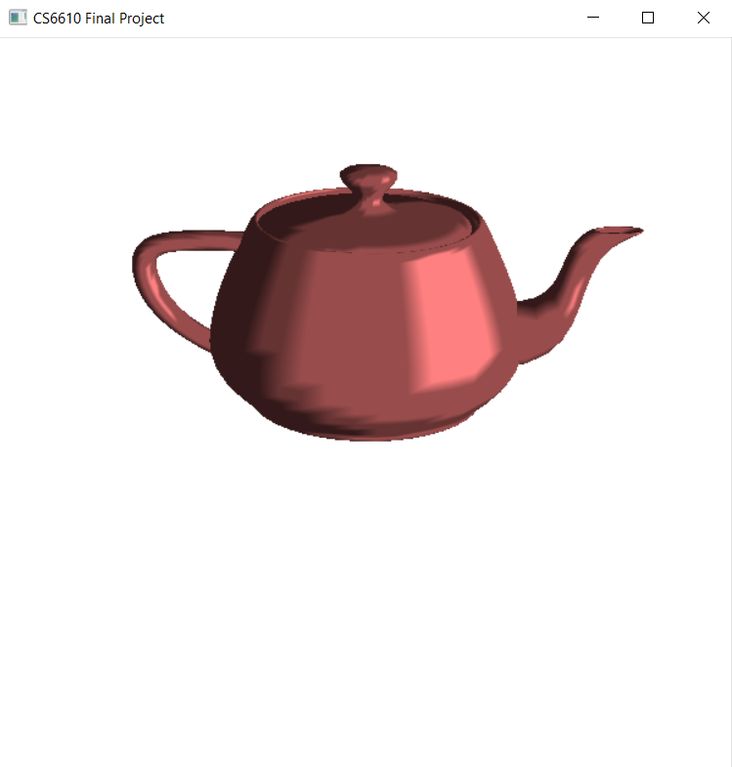
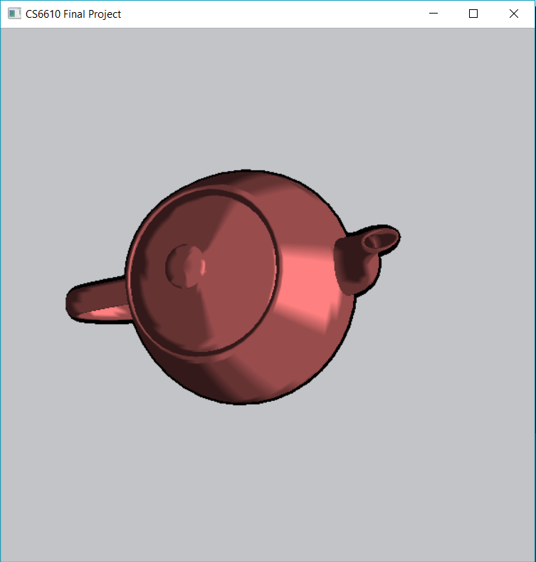
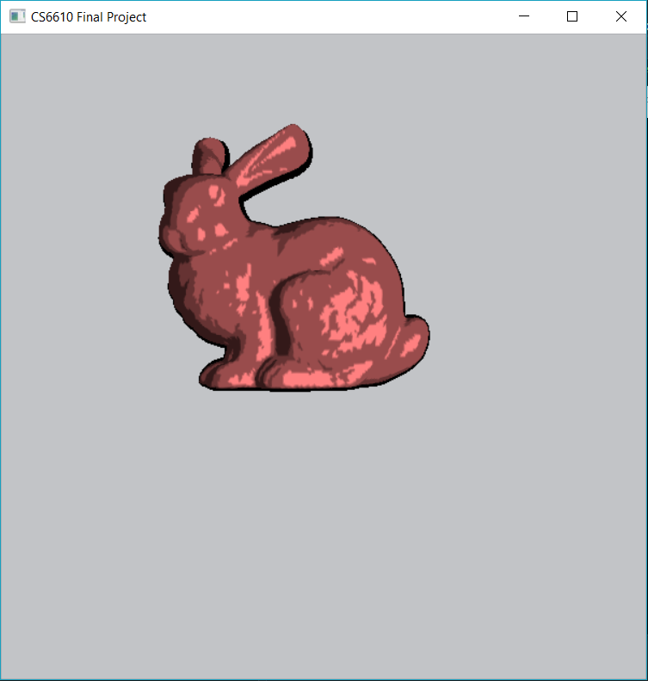
TOON SHADING
Involves shading the objects with lesser colors to provide a more comic/cartoon like look.
Object shaded with toon shading contains sharp change in color.
Teapot with Toon shading With silhouette:

Slide 5
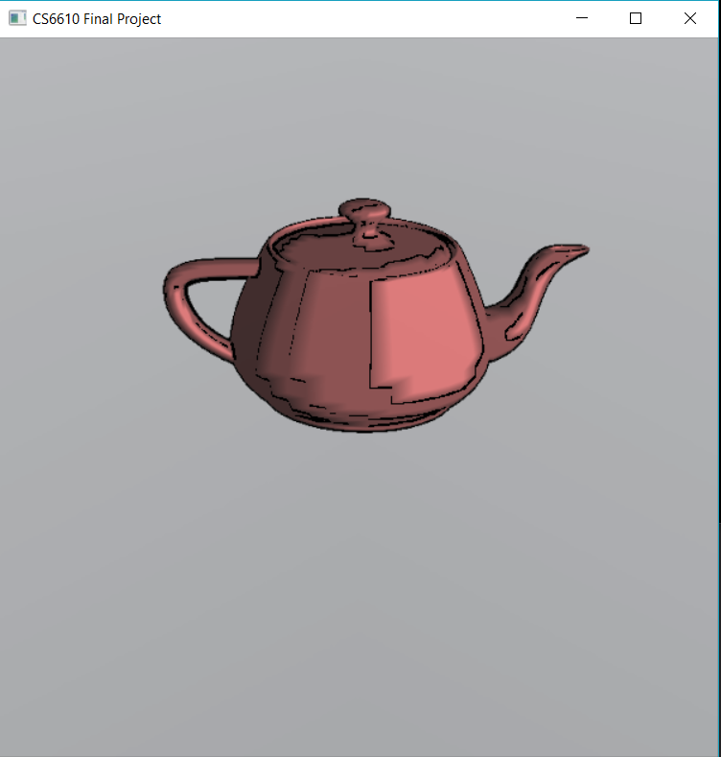
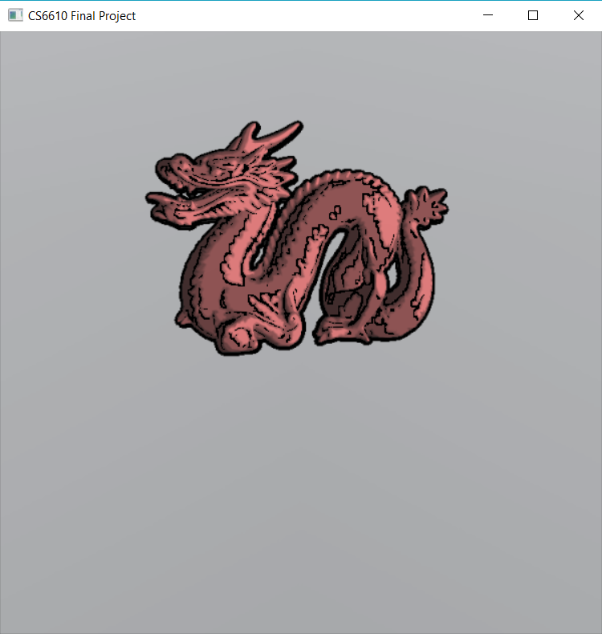
CONTOUR DETECTION
Perform shading on the object to determine its curvature.
Render the object as a texture into the texture buffer.
Apply the rendered texture to a plane
Calculate the edges; if there is a sharp change in color, there could be a change in depth
Color any edges detected as the contour color.

Slide 6
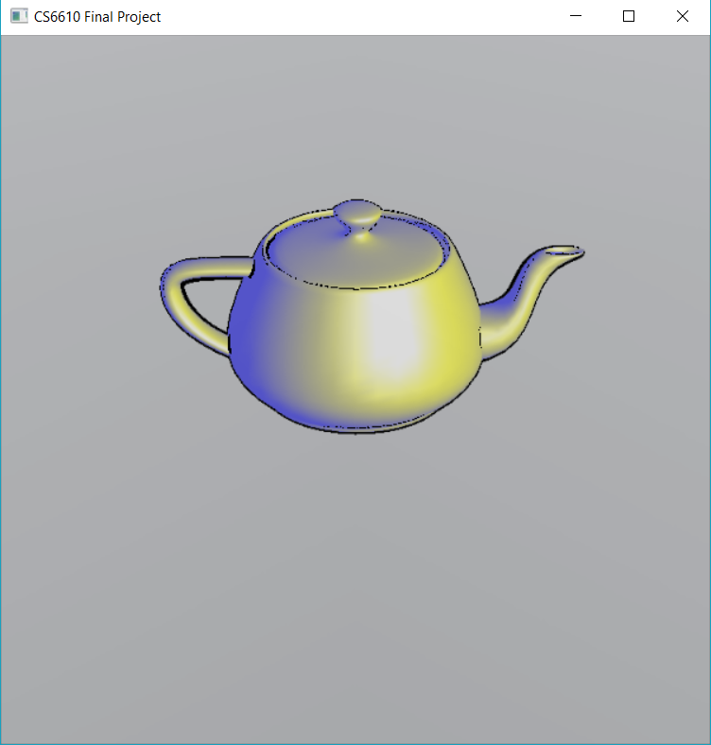
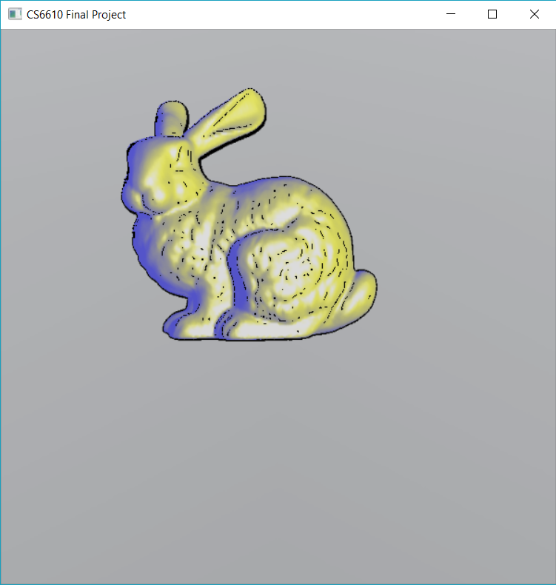
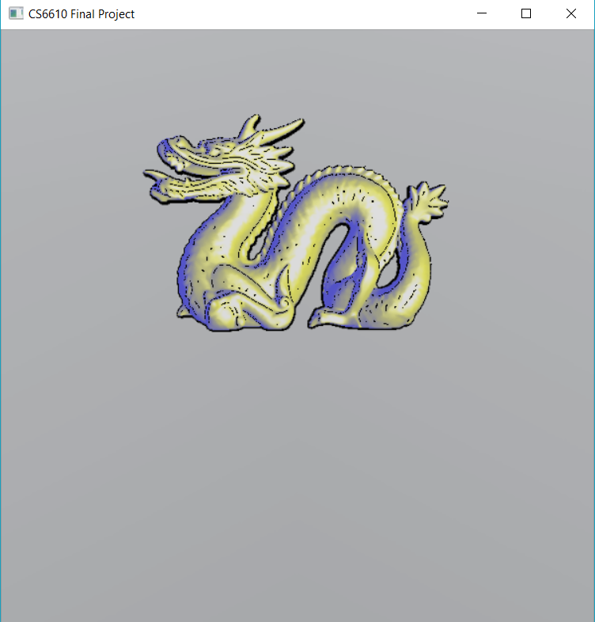
GOOCH SHADING
Generate objects that look like technical illustrations
Two tone shading to denote surface curvature.
Tone1: “warm color” like yellow, orange and red to denote the parts of the object that are closer to the light source
Tone2: “cool color” like blue (or shades of blue) to denote parts of the object away from the light source.
K_{cool_diff} = min(k_{cool} + k_{diffuse}, 1.0)
K_{warm _diff} = min(k_{warm} + k_{diffuse}, 1.0)
K_{final} = mix(k_{cool_diff}, k_{warm_diff,} NdotL)
Color = min(k_{final} + k_{specular}, 1.0)

Slide 7
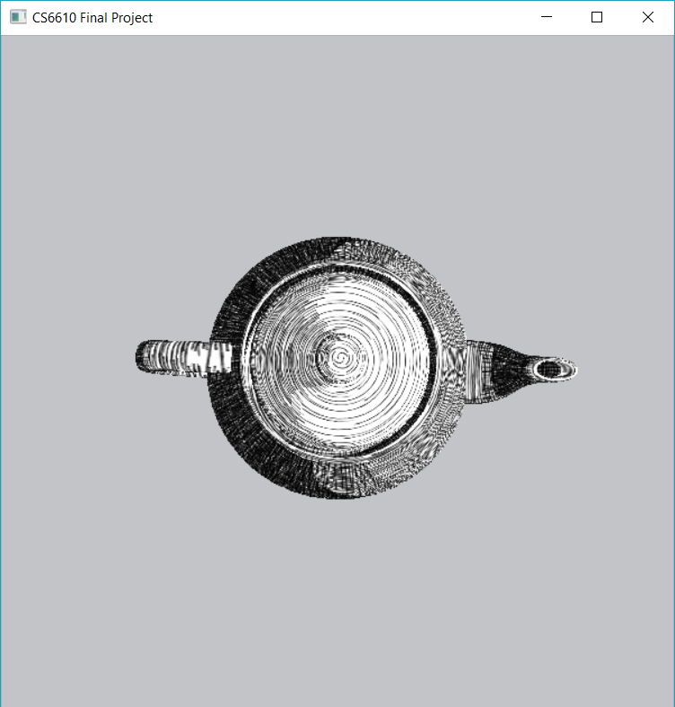
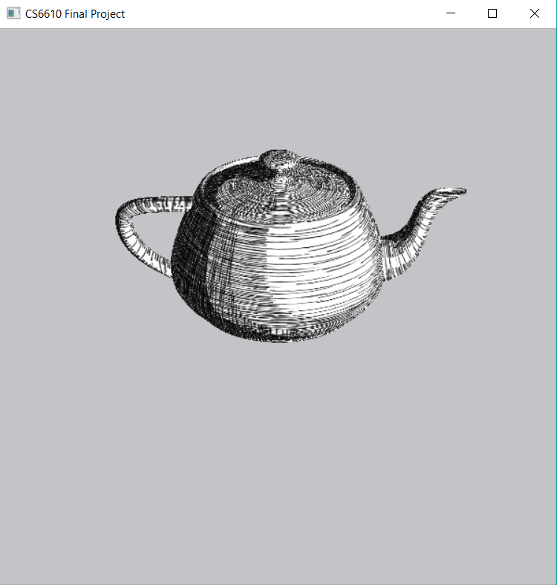
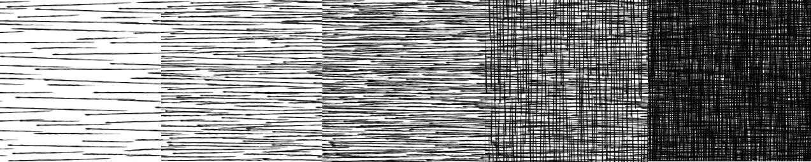
HATCHING
Group of strokes with spatially-coherent direction, helps denote material property, shape of object.
Cross hatching – non parallel strokes; denotes parts of object away from light
Areas of object with high light intensity – parallel strokes
Hatch textures with various hatching levels used

Slide 8
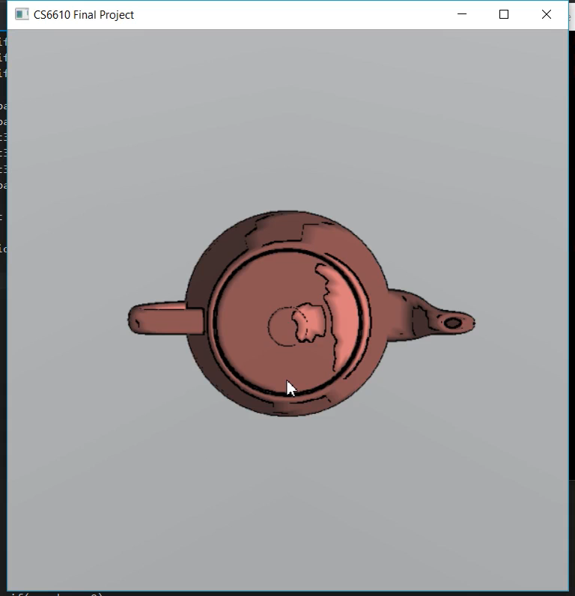
Implementation Video

Slide 9
FUTURE WORK
The hatching method used is based on the light intensity on the object.
A future implementation could include a more complex technique for hatching where the hatches are constant on the object based on shape of the object.
A smooth transition between the levels of hatches – more mipmapping
REFERENCES
GOOCH SHADING: A Non-Photorealistic Lighting Model For Automatic Technical Illustration, Amy Gooch Bruce Gooch Peter Shirley Elaine Cohen, Department of Computer Science University of Utah
HATCHING: Real-Time Hatching, Emil Praun Hugues Hoppe Matthew Webb Adam Finkelstein
Artistic Rendering with Graphics Shaders by Lukas Lang; Eastern Michigan University, Department of Computer Science
Non-Photorealistic Rendering with Pixel and Vertex Shaders; Drew Card, Jason L. Mitchell
https://www.cs.rutgers.edu/~decarlo/contour.html
Online tutorials such as http://www.lighthouse3d.com/tutorials/ and http://sunandblackcat.com/ were also helpful.
http://bentonian.com/Lectures/AdvGraph1314/7.%20OpenGL%20and%20shaders%202.pdf

